Slide 1


“Financial Accounting ”
Journal Entries
17th Feb 2021
Dr.Smita Jape
Dr.V.N.Bedekar Institute of
Management Studies

Slide 2
LEARNING OBJECTIVES
1. Learn how to write Journal entries in the books of accounts
2.Understand entries related to Trade Discount
3. Understand Journal entries of Cash discount
4. Record transactions in the books of accounts

Slide 3
Ananth is a trader dealing in textiles. For the following transactions, pass journal entries for the month of January, 2018.
Jan. Rs.
1 Commenced business with cash 70,000
2 Purchased goods from X and Co. on credit 30,000
3 Cash deposited into bank 40,000
4 Bought a building from L and Co. on credit 95,000
5 Cash withdrawn from bank for office use 5,000
6 Cash withdrawn from bank for personal use of Ananth 4,000
7 Towels given as charities 3,000
8 Shirts taken over by Ananth for personal use 12,000
9 Sarees distributed as free samples 3,000
10 Goods (table clothes) used for office use 200

Slide 4
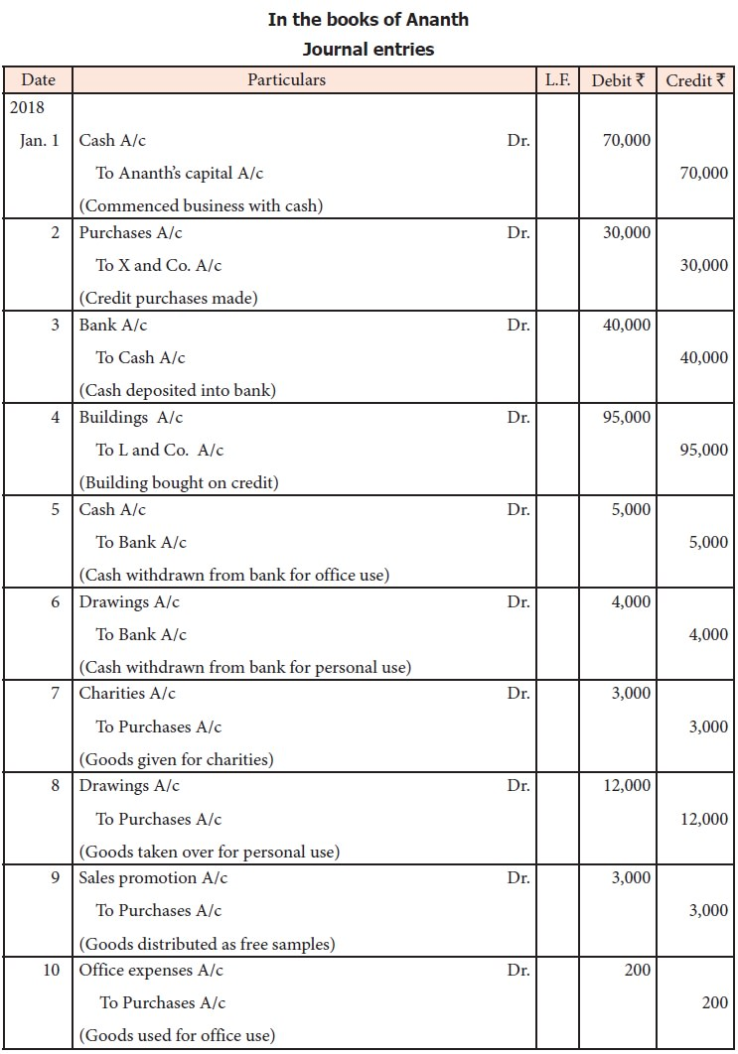

Slide 5
Illustration 10
Arun is a trader dealing in automobiles. For the following transactions, pass journal entries for the month of January, 2018
Jan. Rs.
1 Commenced business with cash 90,000
2 Purchased goods from X and Co. on credit 40,000
3 Accepted bill drawn by X and Co. 20,000
4 Sold goods to D and Co. on credit 10,000
5 Paid by cash the bill drawn by X and Co.
6 Received cheque from D and Co. in full settlement and deposited the same in bank 9,000
7 Commission received in cash 5,000
8 Goods costing Rs. 40,000 was sold and cash received 50,000
9 Salaries paid in cash 4,000
10 Building purchased from Kumar and Co. for Rs. 1,00,000 and an advance of Rs. 20,000 is given in cash

Slide 6
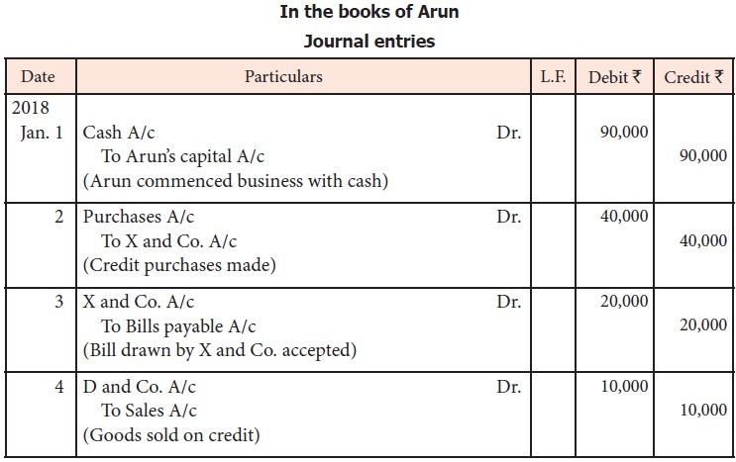
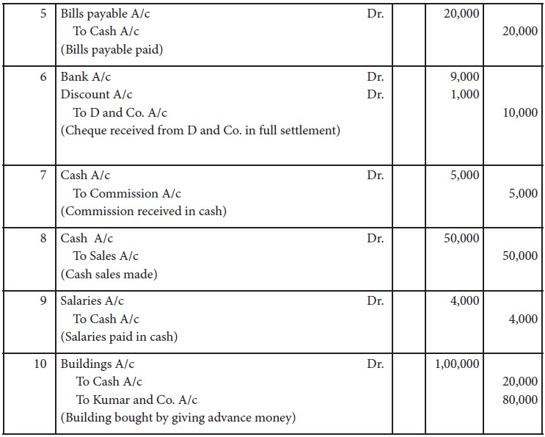
Journal Entries in the books of Arun

Slide 7
Deri is a sole trader dealing in automobiles. From the following transactions, pass journal entries for the month of January, 2018. Jan. Rs.
1 Commenced business with cash 1,00,000
with goods 2,00,000
with buildings 5,00,000
2 Purchased goods from A and Co. on credit 3,00,000
3 Cash deposited into bank 80,000
4 Purchased goods from B and Co. and payment made through credit card 5,000
5 Paid A and Co. through RTGS
6 Sold goods to C and Co. and cheque received 50,000
7 Deposited the cheque received from C and Co. with the bank
8 Purchased goods from Z & Co. and paid through debit card 12,000
9 Stationery purchased for and paid through net banking 6,000
10 Income tax of Deri is paid by cheque 10,000

Slide 8
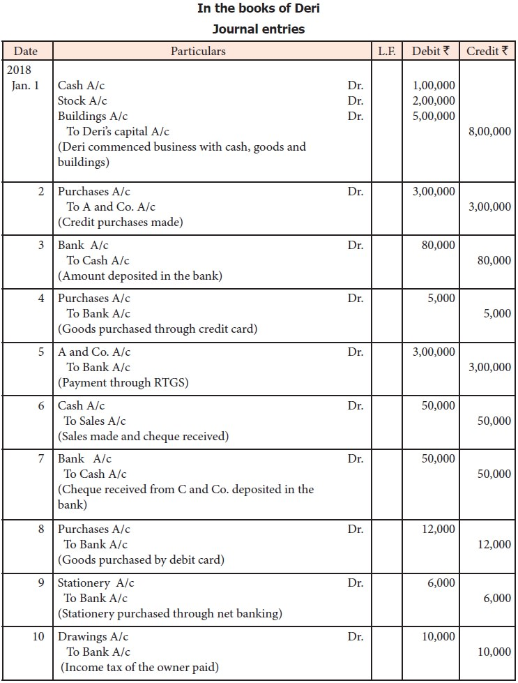

Slide 9
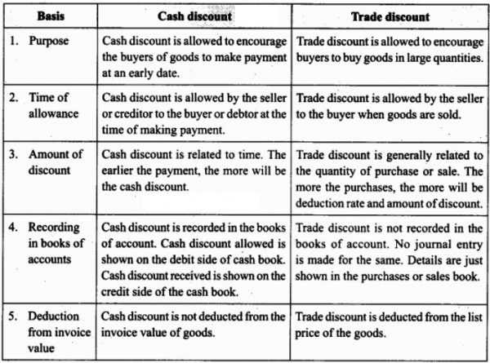

Slide 10
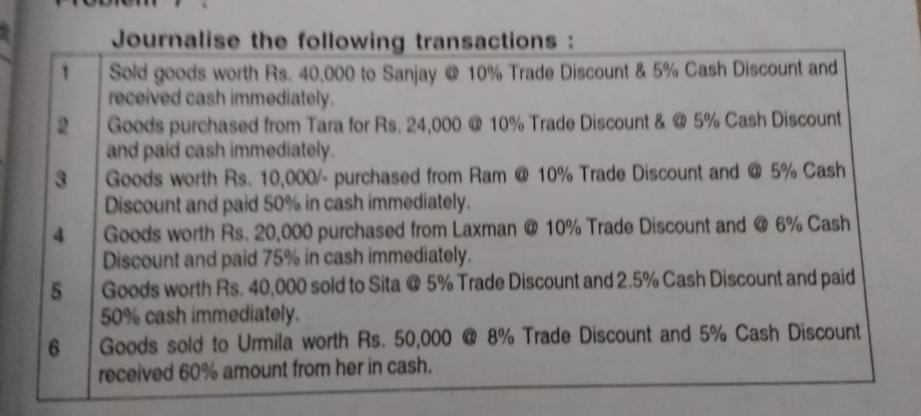

Slide 11
Journalise the following transactions
Sold good worth Rs 40,000 to Mr Sanjay @10% trade discount & 5% cash discount and received cash immediately
Goods purchased from Tata for Rs 24,000 @ 10% trade discount & 5% cash discount and paid cash immediately
Goods worth Rs 10,000 purchased from Mr Ram @ 10% trade discount & 6 % cash discount
and 50% in cash immediately
Goods worth Rs 20,000 purchased from Mr Laxman @ 10% trade discount & 6% cash discount and 75 % in cash immediately
Goods worth Rs 40,000 sold to Ms Sita @ 5% trade discount & 2.5 % cash discount
and paid 50% cash immediately
Goods sold to Urmila Rs 50,000 @ 8 % trade discount & 5 % cash discount
and received 60% amount from her in cash

Slide 12
Working notes
Sales 40000
10% trade discount 4000
36000
5% cash discount 1800
34200/-
purchased from Tata for Rs 24,000
@ 10% trade discount 2400
21,600 /
& 5% cash discount 1080
20,520

Slide 13
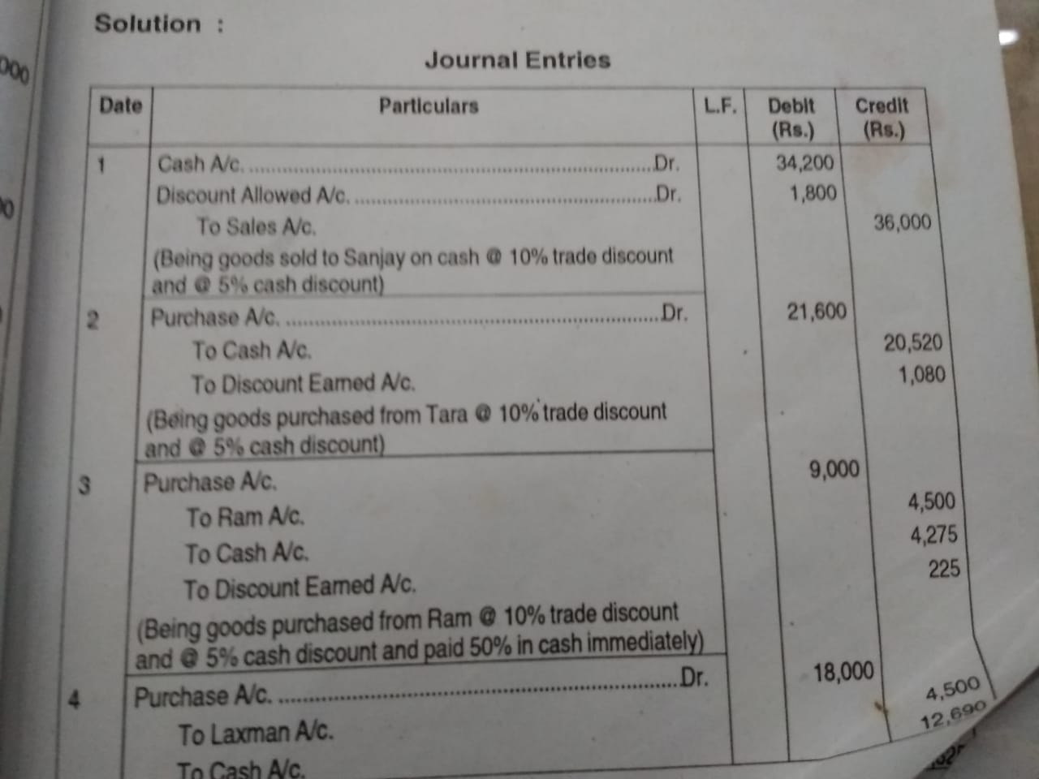

Slide 14
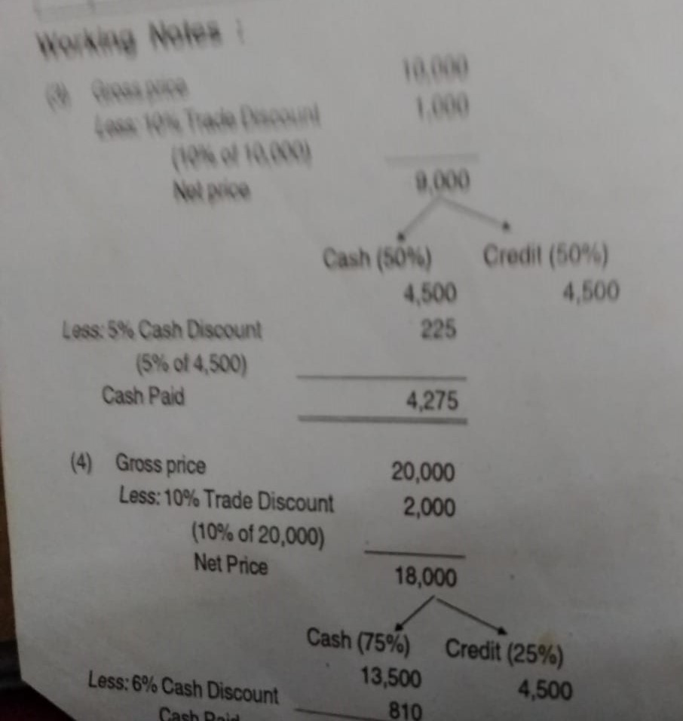

Slide 15
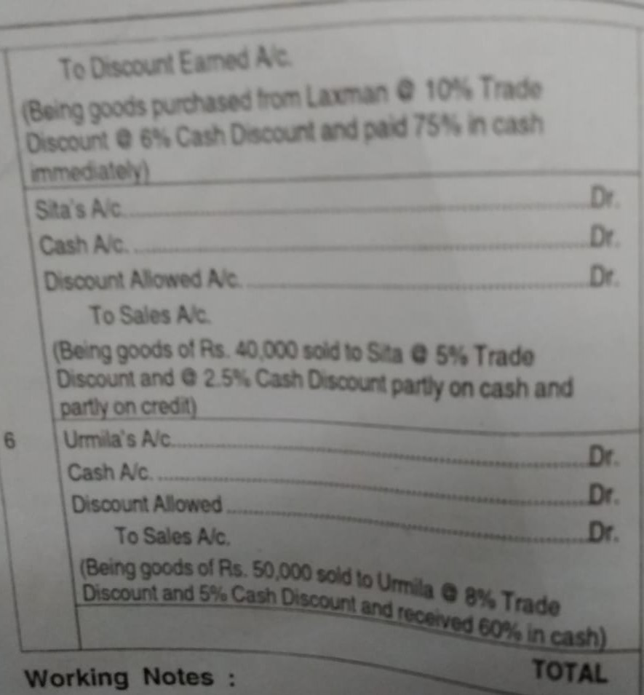

Slide 16
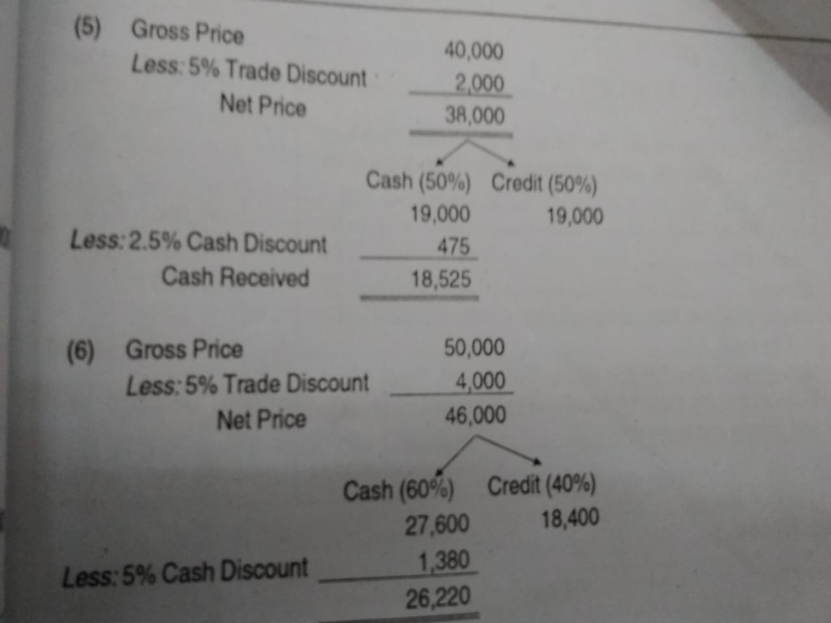

Slide 17
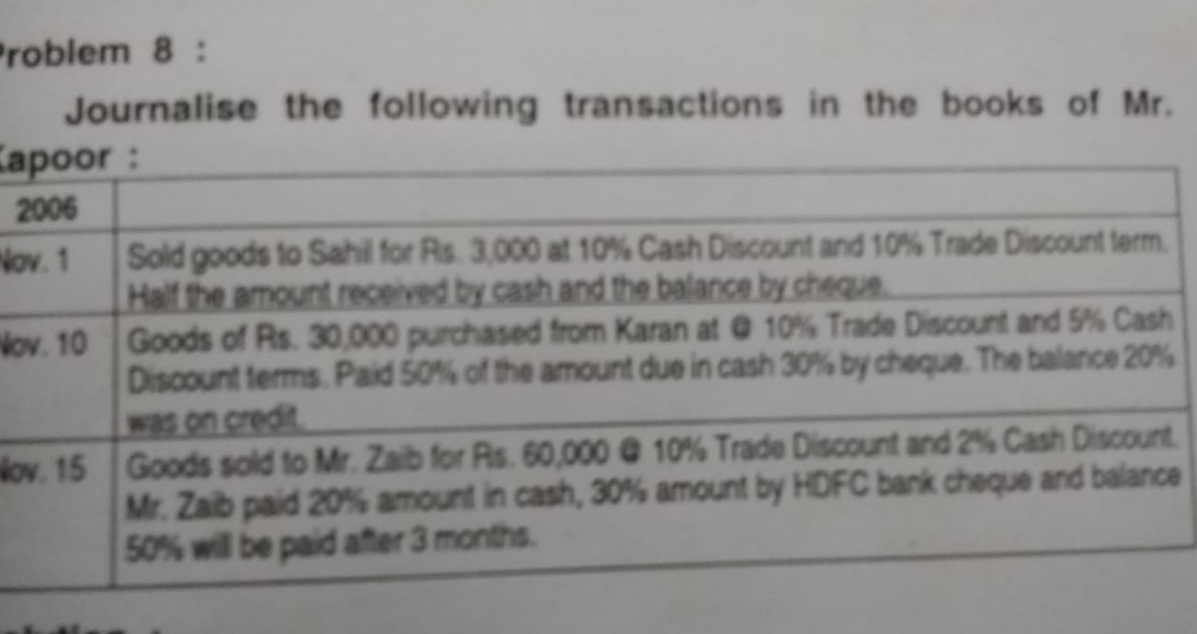

Slide 18
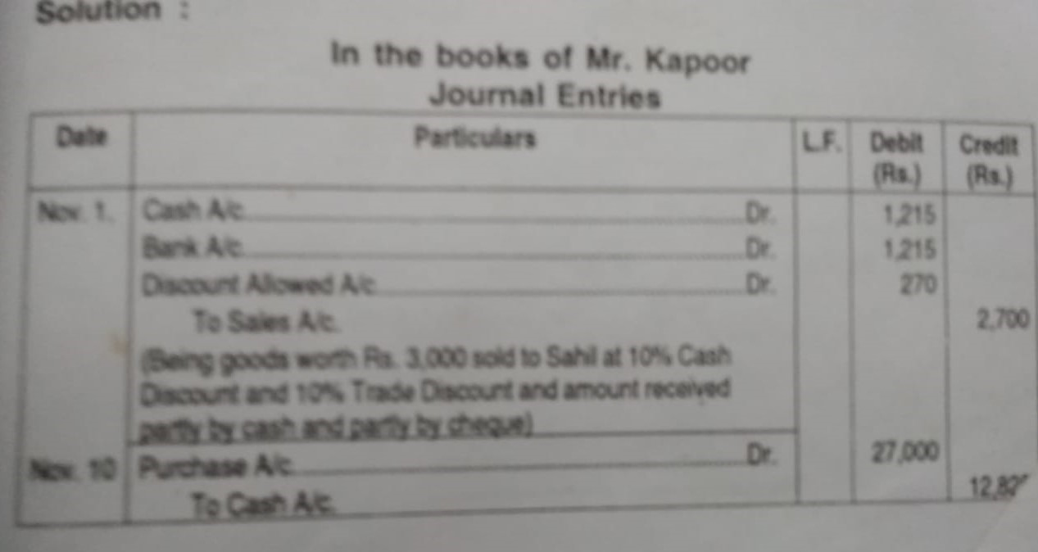

Slide 19
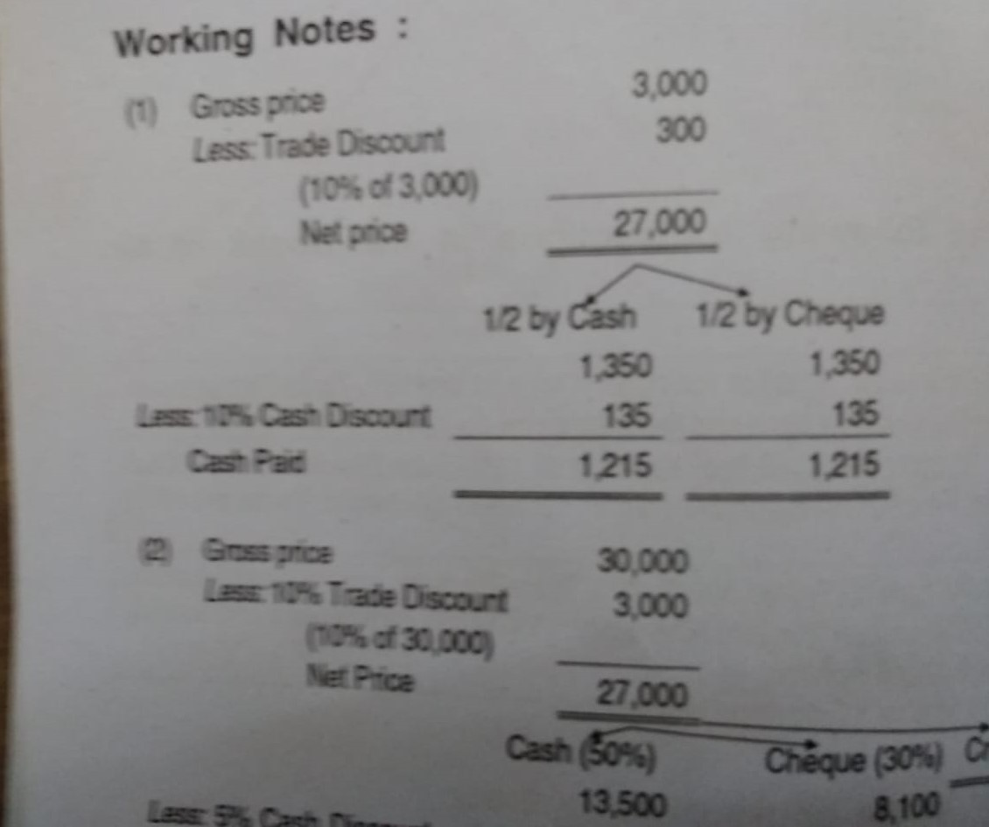

Slide 20
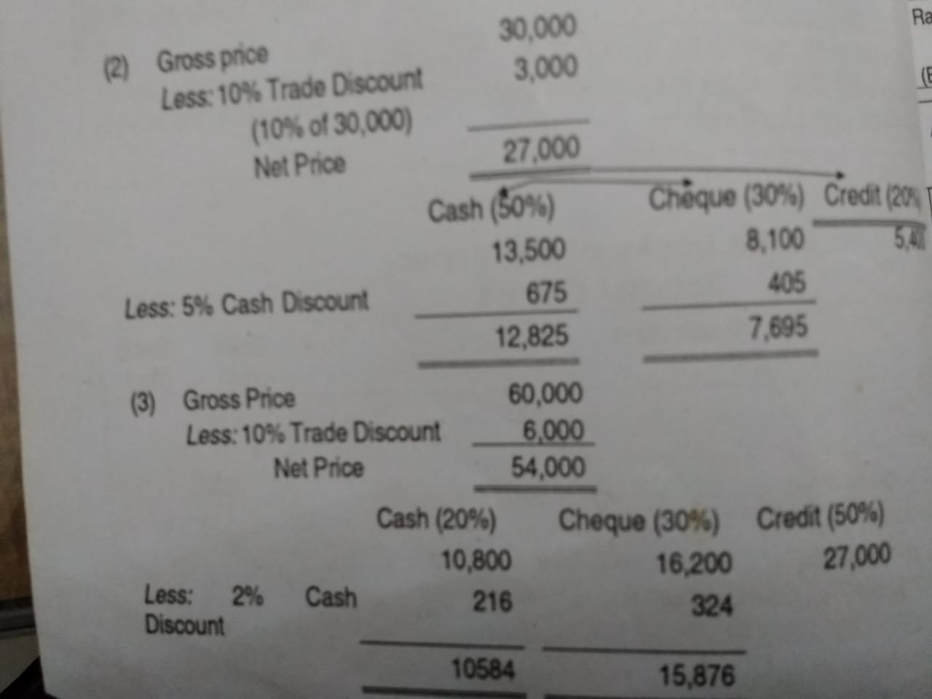

Slide 21
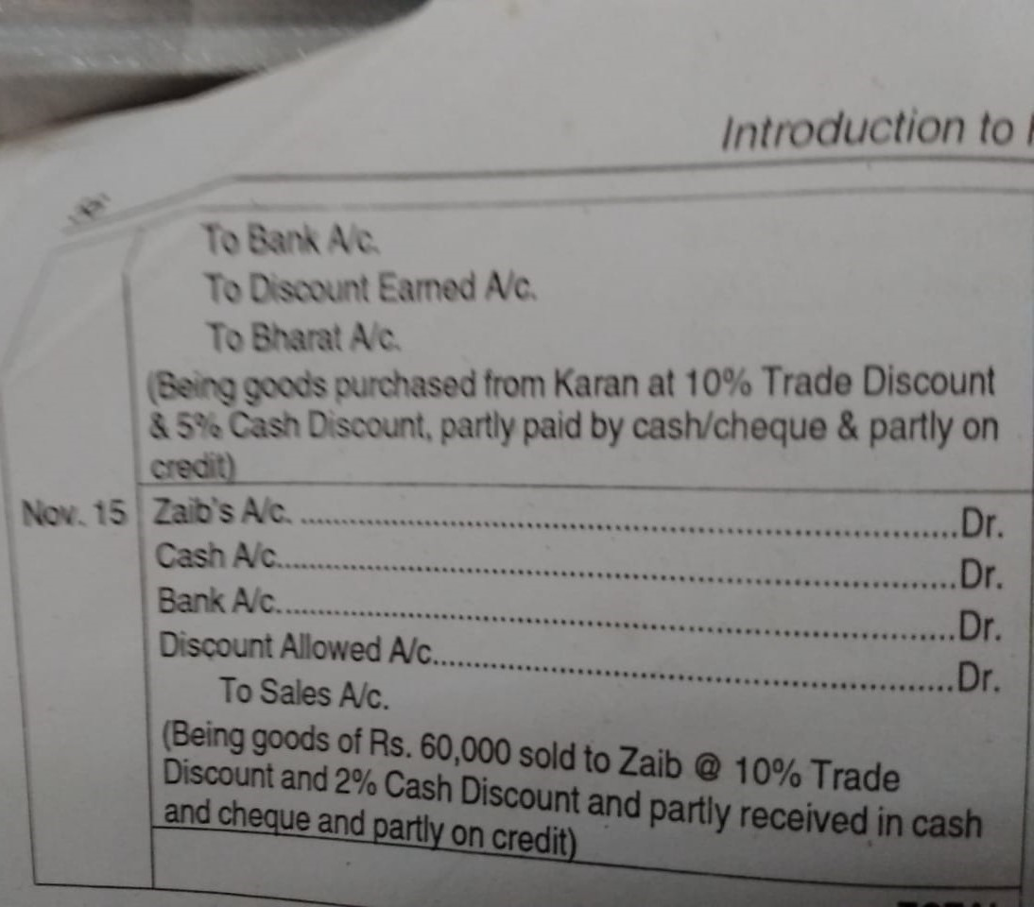

Slide 23
http://www.brainkart.com/article/Journal-entries--Illustration-Problems-with-solution_34156/
Thank You

